Slide 1
Operating System Program 5
I/O System
DMA Device Driver

Slide 2
Outline
We will make a device under /dev by mknod command.
This device can find n-th prime number.
You will implement file operations in a kernel module to control this device.
And implement ioctl function to change the device configuration.
Simulate registers on device by allocating a memory region.
In bonus, you need to write an Interrupt Service Routine to count the interrupt times of the input devices, like keyboard.
1

Slide 3
Component
Kernel Module (Your Work)
Test Program
Driver
Simulate Device
Bonus
We supply this program.
You don't need to modify test program, but you can add test cases to try your module.
Please confirm test program can run with your module.
Try to enable the function written in test program running in kernel space.
Implement write, read, ioctl function etc.
And do the needed operation in init and exit function.
Try to simulate a device in same kernel module.
Implement the work routine function and dynamically enqueue works.
This device can compute the prime number.
Independent work, not related to other work.
Write in same kernel module.
Try to find out the interrupt number of keyboard on SSCloud and implement the ISR function to count interrupt times.
2

Slide 4
Global View
user mode program
ioctl
write
read
set & get device configuration
pass in computed data
transfer out result
kernel module
Device Driver
ioctl
write
read
in & out function
Prime Device
direct enqueue work, computed by CPU
DMA buffer
stuid
block
readable ...
Work Queue
do work by other kernel thread
Work Routine
+ - * /
find prime computation
change readable as software interrupt
when computation completed
3

Slide 5
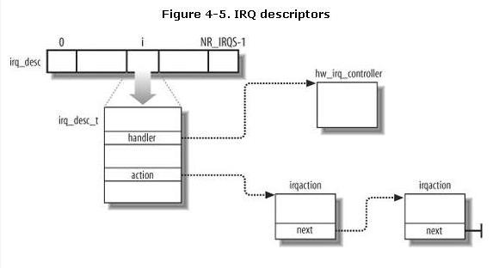
Global View (Bonus)
CPU
Interrupt
APIC
Your Interrupt service routine to count times
Interrupt
Keyboard
Find out keyboard's interrupt number and then register an ISR
4

Slide 6


mknod
We provide a script to use mknod command.
In mknod command:
c means character device.
Followed two number are Major and Minor number to specify device.
You can get available number by MAJOR() and MINOR() macro after alloc_chrdev_region() in module_init() function.
printk major and minor number and then create device node
5

Slide 7
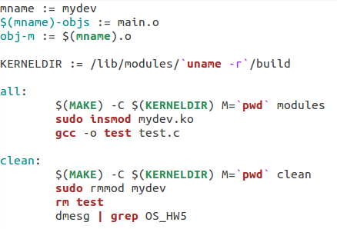
make module
Content of Makefile
We provide a Makefile to compile and test this module.
After compilation, you will get a kernel object file.
Use insmod to insert module.
And then, use rmmod to remove module.
6

Slide 8

init and exit module
You must use init and exit macro to specify init and exit function.
These two function is accompany to insmod and rmmod.
If you didn't specify them, the module cannot be removed.
And these two function is the first step to write a kernel module.
write init and exit macro in module
7

Slide 9
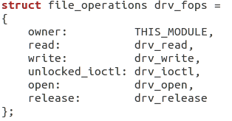
File Operation
In Linux, control device just likes R/W file.
You should write a struct file_ operation to map the operations to functions in this module.
And use cdev_init() at module init to bind cdev and file_ operations.
At here, we focus on implement read, write, and ioctl.
write file operation mapping in module
8

Slide 10
Test Program and printk
Before write module, we need to know what this module do.
So we provide a test program to test this device.
You can modify test program and test your module.
We will check with our test cases.
In kernel module, you need to write printk to help debug and use dmesg command to show message.
To help demo program, your printk must be started with OS_HW5 :function:message.
printk format in module
9

Slide 11
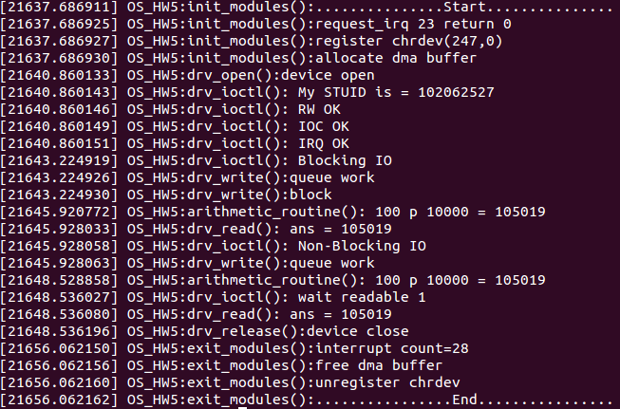
dmesg Sample Output
Execute: make --> ./test --> make clean
Please follow the sample output, print all items in this page
2. Major and Minor number
1. irq_num and return value of request_irq (bonus)
3. allocate DMA buffer
4. ioctl print set and get value
5. write to queue work
6. arithmetic routine to compute answer
7. read to get answer
8. interrupt count (bonus)
9. free DMA buffer
10. unregister device
10

Slide 12
ioctl
In Linux, device provide user mode program ioctl function to change the device configuration.
ioctl define many type of operation with switch case to do coordinated work.
And ioctl use mask to get value from these operation label .
ioctl called in user mode program
1 1

Slide 13
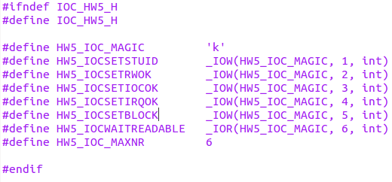
ioc_hw5.h
ioctl labels in ioc_hw5.h
At here, we provide ioc_hw5.h define 6 works.
1. Set student ID: printk your student ID
2. Set if RW OK: printk OK if you complete R/W function
3. Set if ioctl OK: printk OK if you complete ioctl function
4. Set if IRQ OK: printk OK if you complete bonus
5. Set blocking or non-blocking: setting write function mode
6. Wait if readable now (synchronize function):used before read to confirm it can read answer now when use non-blocking write mode .
1 2

Slide 14
ioctl set device argument
HW5_IOCSETSTUID
HW5_IOCSETRWOK
HW5_IOCSETIOCOK
HW5_IOCSETIRQOK
Above ioctl label means setting value in dma_buf at specific address.
These value are not related to device function.
You just need printk that you set these value.
1 3

Slide 15
ioctl set device configuration
HW5_IOCSETBLOCK
This ioctl label means setting the write function mode value in dma_buf.
This value effect the mode of write function.
Please printk the message when you set this value.
value 1 means block mode
value 0 means non-b lock mode
14

Slide 16
ioctl wait readable
HW5_IOCWAITREADABLE
This ioctl label means wait the value of readable in dma_buf changed. It is used after non-blocking write.
Not just get readable value in user mode program.
Use a loop busy wait in the kernel module.
1 5

Slide 17

Write Function
data struct pass in by write function
Pass in a struct.
a is '+', '-', '*', '/', or 'p'
b is operand 1
c is operand 2
Use INIT_WORK() and schedule_work() to queue work to system queue.
These work is top-half work of driver.
write called in user mode program
1 6

Slide 18
Find Prime Operation
The '+', '-', '*', and '/' are just for test.
We will test the find prime operation.
It find c-th prime number bigger than b.
And you can feel the IO latency when execute test program.
We will check your blocking and non-blocking IO by observing the delay of the message printed by test program.
R/W function packaged in arithmetic function in user mode program
1 7

Slide 19
Work Routine
The work you enqueued should be written in a work routine function in module .
These work will be processed by another kernel thread.
These are bottom-half work of driver.
computation is written in a work routine in module
1 8

Slide 20
Blocking and Non-Blocking IO
The test program can use ioctl to set blocking or non-blocking.
Your write function in module can be blocking or non-blocking.
Blocking write need to wait computation completed.
Non-blocking write just return after queueing work.
Read function only has blocking, because no queueing works.
ioctl called to set block or non-block mode in user mode program
1 9

Slide 21
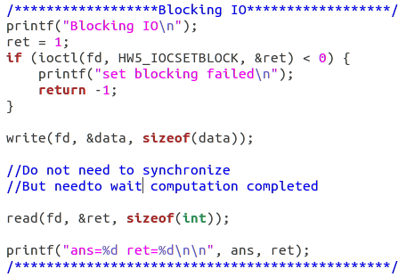
Blocking Write
In test program, we just need a write function.
Do not need another synchronize function.
But block when writing.
Blocking write in arithmetic function of user mode program
20

Slide 22
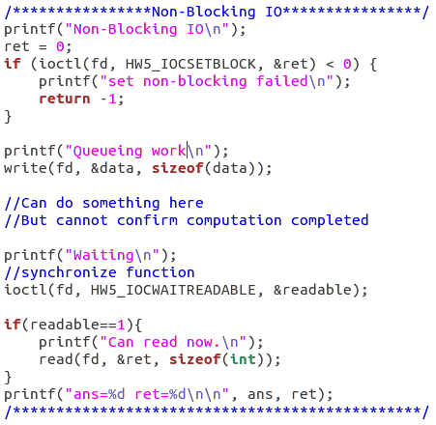
Non- Blocking Write
In test program, we can do something after write function.
Write function return after queueing work, it is non-blocking.
But need another synchronize function to wait work completed .
Non- Blocking write in arithmetic function of user mode program
2 1

Slide 23
Interrupt driven IO
When implementing blocking write and synchronize function, they use a while loop busy waiting the interrupt.
You can use a variable to simulate the interrupt.
At the final of the work routine function, change this variable as triggering the interrupt.
And then, blocking write and synchronize function can exit the while loop.
22

Slide 24
Read Function
Pass the computed result to user mode test program.
Get answer from dma_buf.
And then, clear the readable and answer value in dma_buf for next write.
We assume this device can only process one work at same time.
23

Slide 25
Pass value from user mode
If you don't know how to pass value from test program to your module. You can search the followed API.
Pass primitive type
get_user: user space -> kernel space
put_user: kernel space -> user space
Pass a block of memory with specified size
copy_from_user: user space -> kernel space
copy_to_user: kernel space -> user space
2 4

Slide 26
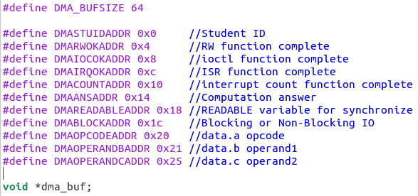
DMA Buffer
To simulate register and memory on device, you need to kmalloc a dma buffer.
This buffer is as IO port mapping in main memory.
What device do is written in work routine function . This function get data from this buffer.
All defined value are written in dma_buf
Do not declare other global variable to save value defined below
You can declare other structure as you want, if it help you write this module.
25

Slide 27
DMA Buffer -- Where to Use
#define DMASTUIDADDR 0x0 // ioctl : set and printk value
#define DMARWOKADDR 0x4 // ioctl : set and printk value
#define DMAIOCOKADDR 0x8 // ioctl : set and printk value
#define DMAIRQOKADDR 0xc // ioctl : set and printk value
#define DMACOUNTADDR 0x10 // ISR : set value, exit_module : printk value
#define DMAANSADDR 0x14 // work routine : set value, read: printk value
#define DMAREADABLEADDR 0x18 // ioctl : check value, write : check value
#define DMABLOCKADDR 0x1c // ioctl: set and printk value, write: check value
#define DMAOPCODEADDR 0x20 // write: set value, work routine: get value
#define DMAOPERANDBADDR 0x21 // write: set value, work routine: get value
#define DMAOPERANDCADDR 0x25 // write: set value, work routine: get value
26

Slide 28
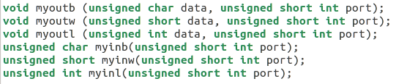
in and out function
You need to implement in & out function to access dma buffer just like physical device.
out function is used to output data to dma buffer.
in function is used to input data from dma buffer.
'b', 'w', 'l' are data size.
The 6 in & out function in module to operate dma_buf
2 7

Slide 29
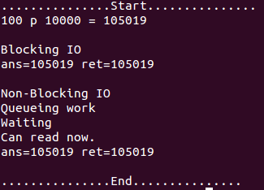
Test Program Output
Output of user mode program
ans is computed in test program.
ret is computed in module and return by read function.
Show some message that is blocking or non-blocking in test program.
2 8

Slide 30
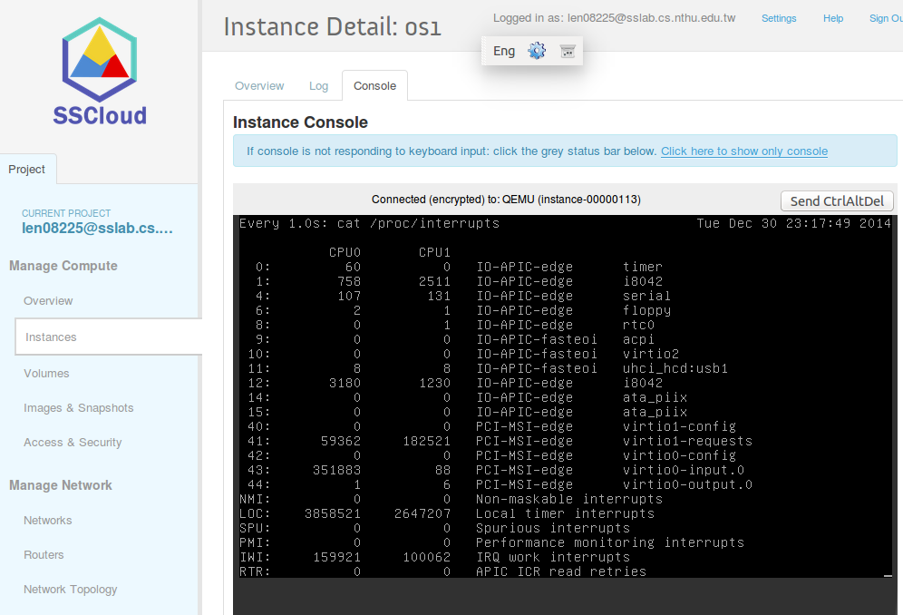
Bonus
We want you find out the number of keyboard's interrupt on SSCloud.
The number may differ by login with putty or SSCloud web page.
Please test on SSCloud web page. Because there may be some problem by login with putty.
content of cat /proc/ interrupts
Count the interrupt times of input device like keyboard.
Hint: watch -n 1 cat /proc/ interrupts
Use request_irq() in module_init to add an ISR into an IRQ number's action list.
And free_irq() when module_ exit, otherwise kernel panic.
Please define IRQ_NUM at head of code.
2 9

Slide 31
Grading Policy
We will test 3 test cases, you can get 15 points by passing cases.
If your code has problems followed, you will not get any point.
compile error and warning, kernel panic, system crash
output message miss some items in page 10
printk message not add label
cannot execute the test flow by Makefile
cannot remove module normally
3 0

Slide 32
Summit format
Your module should be written in a file called main.c if you do not change the Makefile.
Please put all of your source codes, test.c, Makefile and README.txt into a folder named OS_homework5, compress the folder OS_homework5 into OS_homework5. tar.gz, and upload OS_homework5. tar.gz to iLMS system.
If you write the bonus, please write down the interrupt number you chooses in README.txt and describe you test by SSH remote or on web interface.
Don't copy others work, or both of you will get 0 points.
31

Slide 33
Attention
Please confirm your module can be used on VM of SSCloud. We will test on VM.If your module fail to execute, we don’t test it again in other platform.
Please check all your code is in the compressed file and write the correct path in Makefile. We won't modify Makefile for you.
Don't summit if your code is non-completed or may crash the system. It will delay the demo progress of everyone, and you won't get any points.
We don’t accept any incorrect format in this homework. If you don’t follow our rules, you will get 0 points.
3 2

